Slide 1
Query Graph Generation for Answering Multi-hop Complex Questions from Knowledge Bases
Yunshi Lan, Jing Jiang
Singapore Management University
ACL-2020
Li Wei
2021-2-5
Code: https://github.com/lanyunshi/Multi-hopComplexKBQA

Slide 2
Introduce
Previous work on answering complex questions from knowledge bases usually separatelyaddresses two types of complexity:
1、questions with constraints
Who was the first president of the U.S.?
2、questions with multiple hops of relations.
Who is the wife of the founder of Facebook?
Main challenge
how to restrict the search space
Notes:
以前关于从知识库中回答复杂问题的工作通常分别解决两种类型的复杂性:
1、有约束的问题
谁是美国第一任总统？
2、有多个关系跃点的问题
谁是Facebook创始人的妻子？

Slide 3
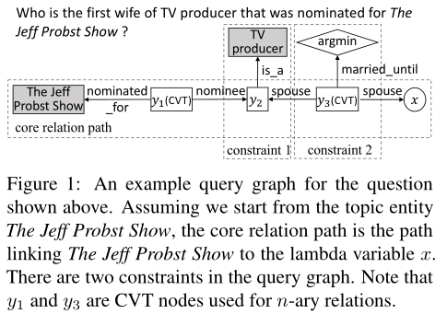
Preliminaries
A query graph has four types of nodes:
1、A grounded entity (shaded rectangle) is an existing entity in the KB.
2、 An existential variable (unshaded rectangle) is an ungrounded entity.
3、A lambda variable (circle) is also
an ungrounded entity but it represents the answer.
4、an aggregation function (diamond) is a function such as argmin and count that operates on a set of entities.
Notes:
查询图包含四种类型的节点：
1、接地实体（阴影矩阵）：知识库中存在的实体
2、存在变量（无阴影矩阵）：存在变量，未确定实体
3、lambda变量（圆）：未接地实体，表示答案
4、聚合函数（菱形）：对一系列实体进行的操作，如count和argmin

Slide 4
Preliminaries
We summarize the staged query graph generation method as follows:
1、Starting from a grounded entity found in the question (referred to as a topic entity), identify a core relation path linking the topic entity to a lambda variable.
2、From a core relation path identified in Step 1,attach one or more constraints found in the question.
3、With all the candidate query graphs generated from Step 1 and Step 2, rank them by measuring their similarities with the question.
4、Execute the top-ranked query graph against the KB to obtain the answer entities.
Notes:
将分阶段查询图生成方法总结如下:
1、从问题中的接地实体(称为主题实体)开始，确定一个核心关系路径，将主题实体链接到lambda变量。现有的工作考虑包含单个关系的核心关系路径
2、从步骤1中确定的核心关系路径中，附加问题中找到的一个或多个约束。约束由带关系的接地实体或聚合函数组成。
3、对步骤1和步骤2生成的所有候选查询图，通过测量它们与问题的相似性对它们进行排序。这通常是通过神经网络模型(如CNN)完成的。
4、对KB执行排名靠前的查询图，以获得答案实体。

Slide 5
Motivation
If we allow core relation paths up to 3 hops, on average we will have around 10,000 core relation paths per question, which is computationally very expensive.
We observe that constraints found in a question can often help reduce the search space and guide the generation of the core relation paths towards the right direction.

Slide 6
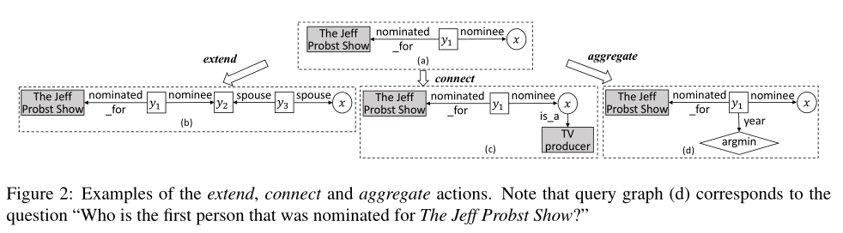
Method
Query Graph Generation
We allow the following actions to grow a query graph:
1、Extend.An extend action extends the core relation path by one more relation in R.
2、Connect.A connect action links such a grounded entity e to either the lambda variable x or an existential variable connected to x that is a CVT node.
3、 Aggregate. An aggregate action attaches the detected aggregation function as a new node to either the lambda variable x or an existential variable connected to x that is a CVT node.
Notes:
（1） extend操作将核心关系路径再扩展一个R中的关系，R是知识库关系的集合。如果当前查询图只包含一个主题实体e，则extend操作会在KB中找到一个链接到e的关系r，并用r来扩展路径，并使得r的另一端成为lambda变量x。如果当前查询图有lambda变量x，extend操作将x更改为存在变量y，通过对KB执行当前查询图来查找KB中所有连接y的实体，找到连接这些实体之一的关系r，最后在查询图里将r连到y上，r的另一端成为新的lambda变量x。
（2）除了当前核心关系路径开头的主题实体外，问题中经常会发现其他固定实体。connect操作将这样一个固定的实体e连接到lambda变量x，或者连接到与x相连的存在变量上，也就是CVT节点（本文只考虑与lambda变量相连的存在变量）。要决定使用哪个关系r来链接e和x，我们可以通过执行当前查询图来找到x的所有bindings，然后找到这些实体之一和e之间存在的关系。
（3）使用一组预定义的关键字从问题中检测出aggregate 函数。聚合操作将检测到的聚合函数作为新节点附加到lambda变量x或连接到作为CVT节点的与x相连的存在变量上。

Slide 7
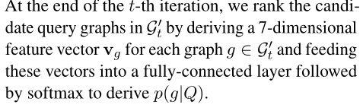
Method
Query Graph Ranking
1、The first dimension of vgcomes from a BERT-based semantic matching model.
Figure 2(a)：(the, jeff, probst, show,nominated, for, nominee)
2、the accumulated entity linking scores
of all grounded entities in the query graph.
3、 the number of grounded entities ap-
pearing in the query graph.
4、 the numbers of entity types.
5、temporal expressions .
6、superlatives in the query graph.
7、the number of answer entities of the query graph.
Notes:
Vg的第一个维度来自一个基于BERT的语义匹配模型。具体地说，我们通过遵循构造g所采取的操作顺序，并将每个步骤中涉及的实体和关系的文本描述按顺序添加到序列中，从而将g转换为token序列。存在变量和lambda变量被忽略。
第一个维度是查询图中所有固定实体的累计实体链接分数。第二个是查询图中出现的固定实体的数量。第三到第五个分别是查询图中实体类型、时间表达和最高级的数量。最后一个特性是查询图对应的答案实体的数量

Slide 8
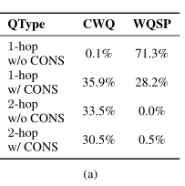
Datasets

Slide 9
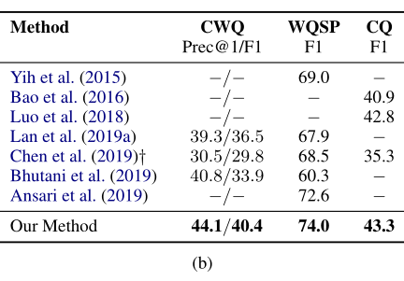
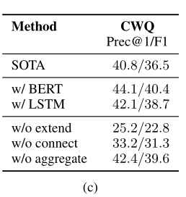
Results
Notes:
为了更好地理解模型，本文还进行了消融研究。为了验证我法的有效性并不是由于使用了BERT，我们用LSTM代替了BERT。我们可以在表1（c）中看到，基于LSTM的方法仍然可以优于先前的技术水平。这说明本文的模型的有效性不仅仅是因为使用了BERT。还测试了方法的三个版本，每个版本都删除了一个操作，以了解是否所有三个操作都是必需的。结果也显示在表1c中。可以看到聚合作用是最不重要的作用，而extend作用是最重要的作用。然而，需要将这三个动作结合起来，以达到最佳性能。

Slide 10
Error Analysis
We randomly sampled 100 error cases for manual inspection. We summarize the errors into the following categories:
1、Ranking Error: There are 65% of errors coming from misprediction of query graphs.
2、Topic Linking Error: We observe that there are 27% of errors occurring due to the entity or expression linking error.
3、Generation Limitation: The limitation of query graph generation strategies leads to 6% of errors.

Slide 11
Thank you！

